Slide 1
Progress Report #6 Yerzhanov Beksultan 200103513
Tashim Darkhan 200103208

Slide 2
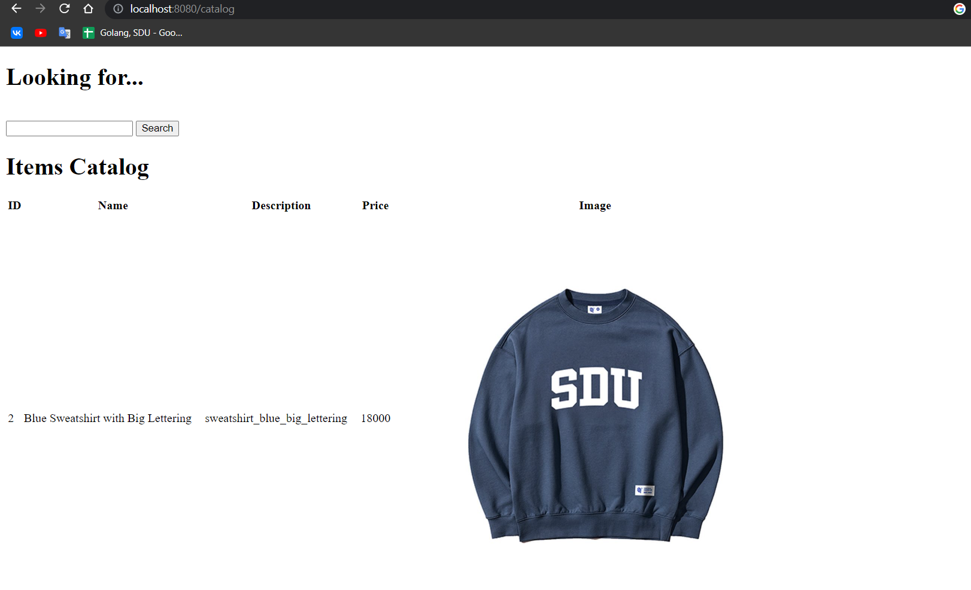
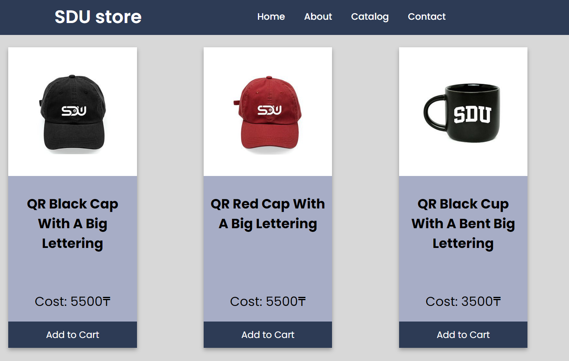
We add design to our Catalog Page
Before
Now

Slide 3
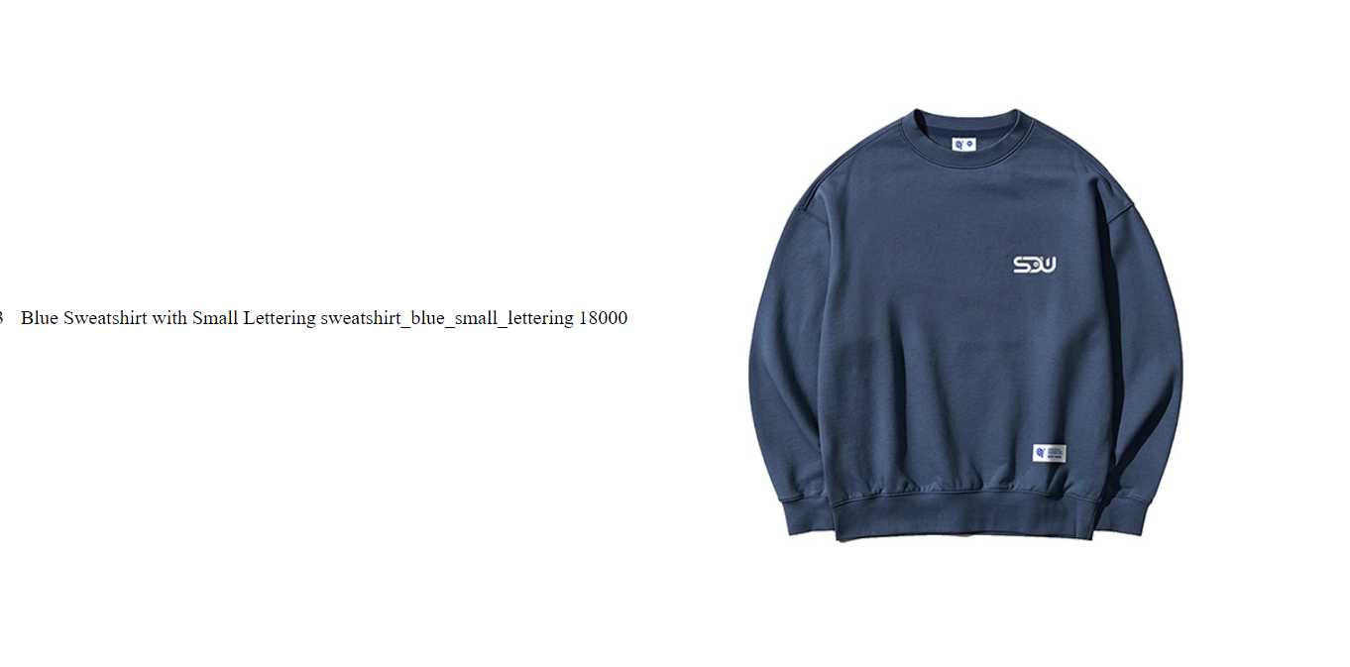
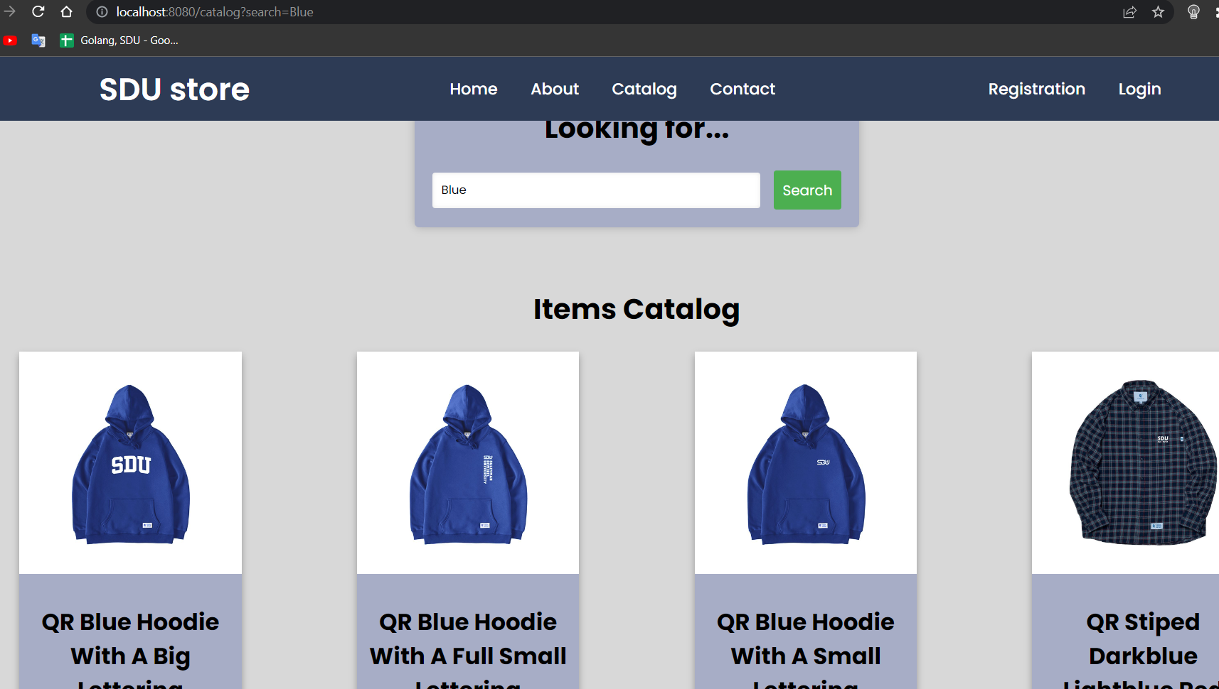
Also, we fixed search result
Before
Now

Slide 4
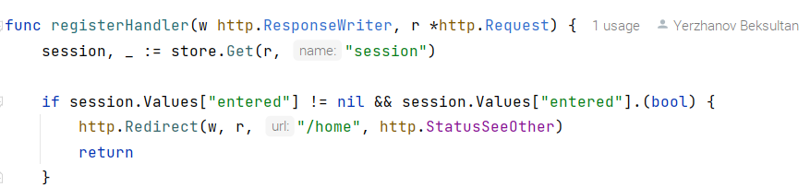
Added prevention from re-registration and re-authorization
We use “github.com/gorilla/sessions” library for that purpose
session.Values["entered"] = true
err = session.Save(r, w)

Slide 5
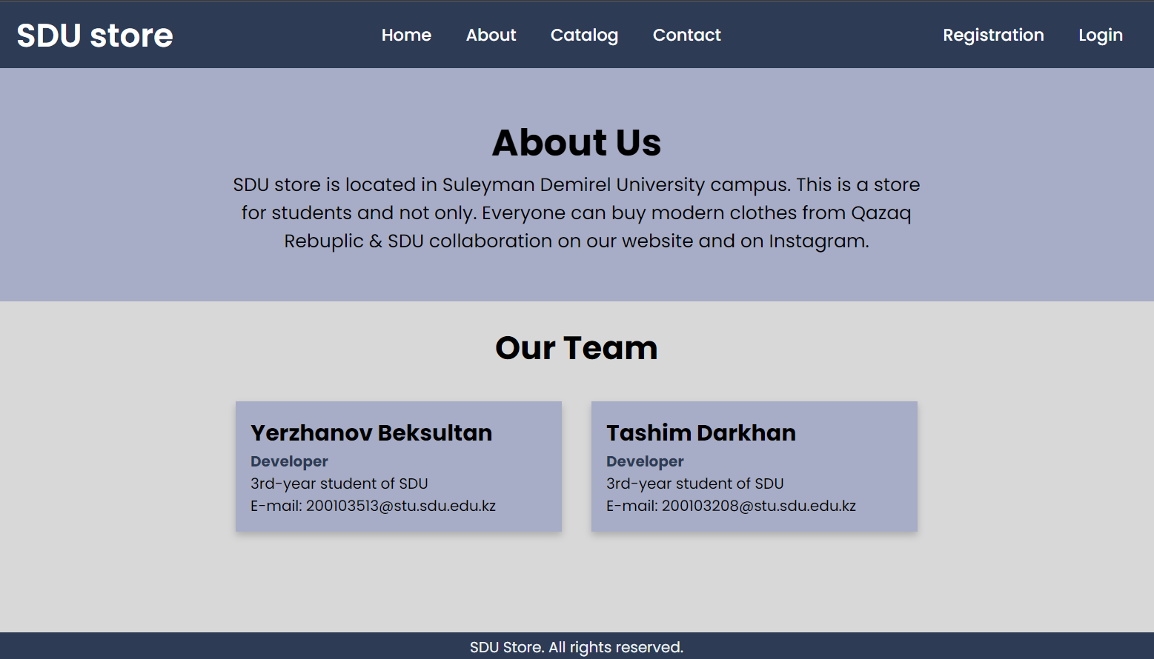
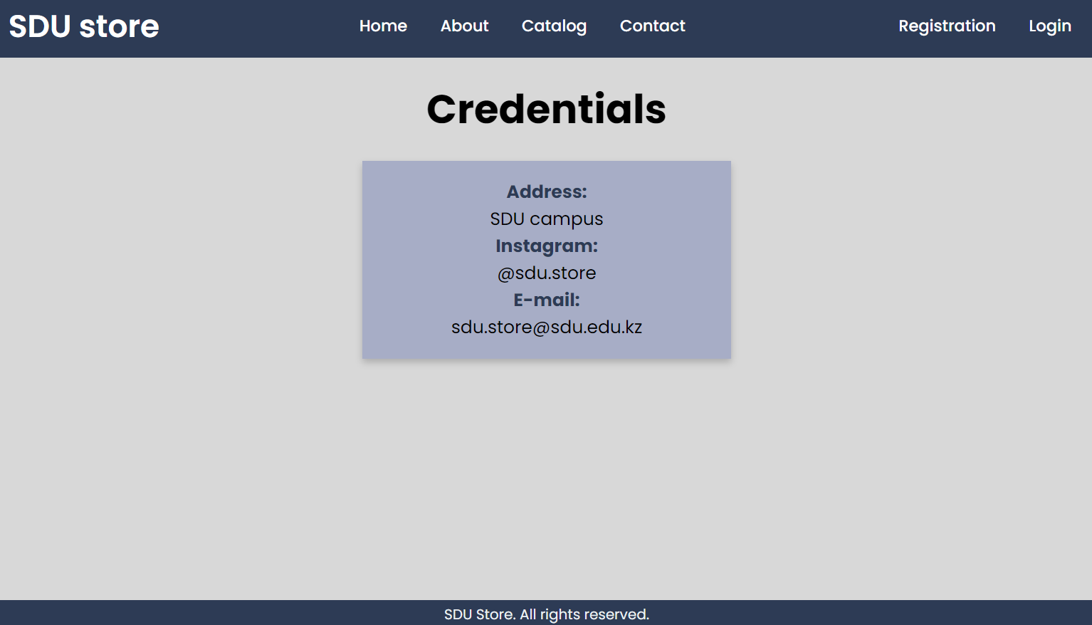
Also we added “about” and “contact” pages

Slide 6
For mid 2, we started to adding rating system

Slide 7
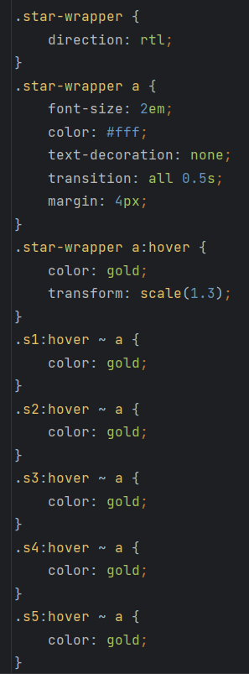
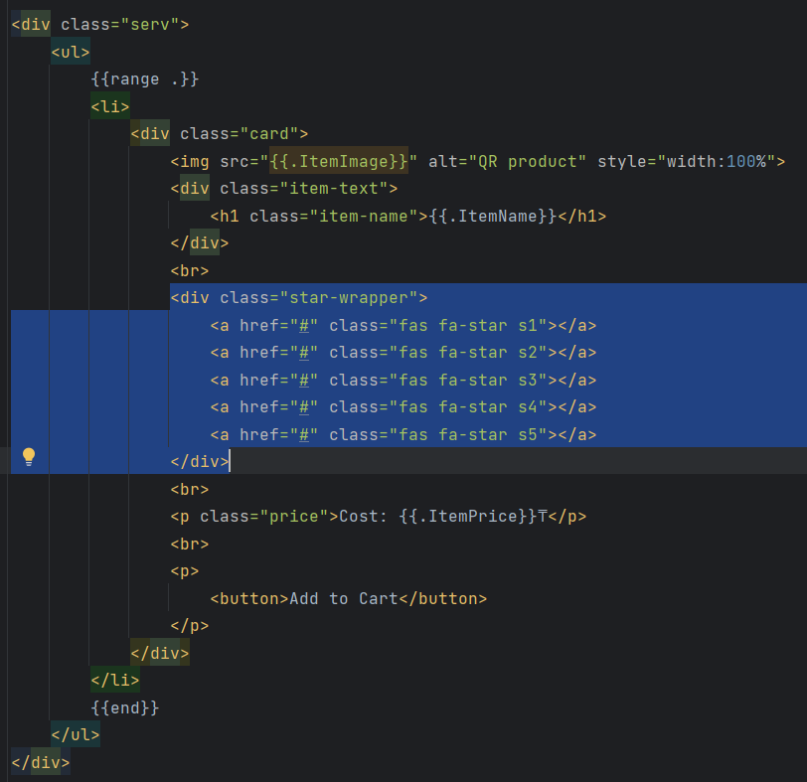

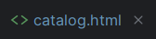
html and css for rating system

